Slide 1

Black Friday Deals Dashboard
Adwoa Nhyira Attafuah-Wadee
Shreeya Chitnis
Lina Botero

Slide 2





Introduction
An intuitive web-based application designed for exploring Black Friday deals.
Users can select specific product categories to view detailed deal descriptions.
Provides sentiment analysis of customer reviews and generates visual insights.
Empowers users with future price predictions, aiding in market trend analysis.

Slide 3

Streamlining Black Friday Deal Analysis
Gather relevant data.
Thoroughly process and clean the data to ensure accuracy.
Filter the dataset to focus specifically on Black Friday deals.
Conduct sentiment analysis on customer reviews.
Integrate all components seamlessly into a user-friendly dashboard using Streamlit.
Develop model to predict Black Friday deal of a specific product category for the next year.

Slide 4
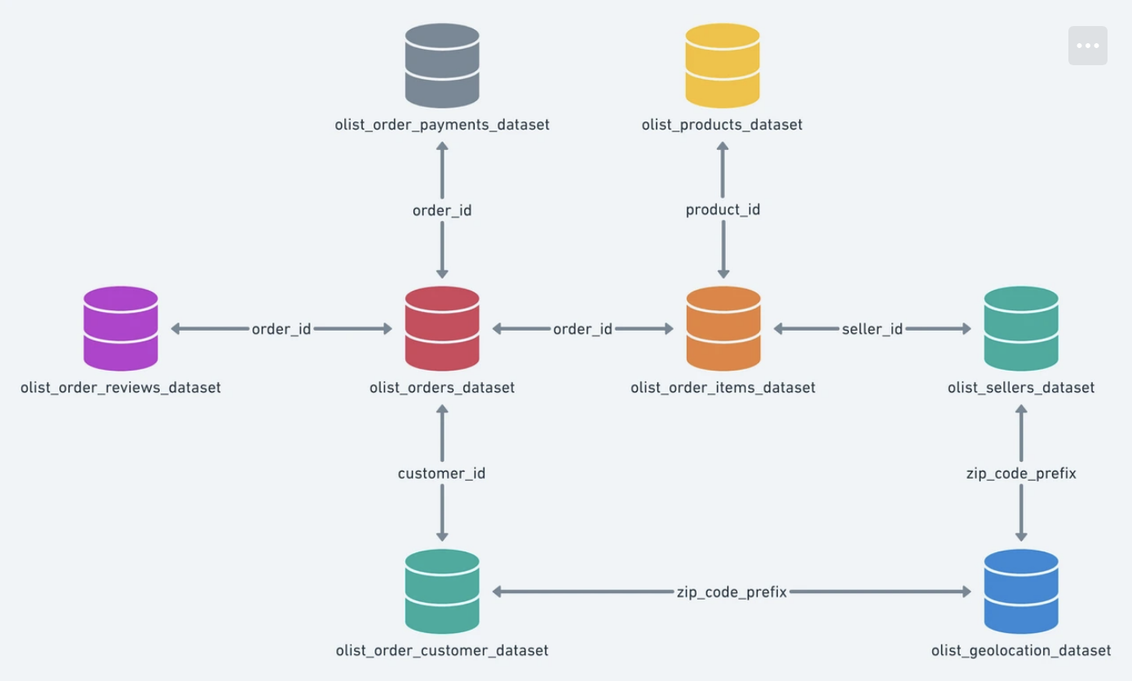
Exploring Brazilian E-Commerce with Olist Dataset
Utilized the Brazilian E-Commerce Public Dataset provided by Olist.
It contained a comprehensive collection of 100k orders spanning 2016 to 2018.
Orders in dataset were placed across various marketplaces in Brazil for insightful exploration and analysis.

Slide 5

Data Preparation
The Olist data was made up of 9 datasets.
These datasets were merged for the predictive modelling:
olist_order_dataset,
olist_order_items_dataset,
olist_products_dataset,
olist_orders_customers_dataset,
olist_orders_reviews_dataset,
olist_sellers_dataset.
These datasets were merged for the predictive modelling:
olist_order_dataset,
olist_order_items_dataset,
olist_products_dataset,
olist_orders_customers_dataset,
olist_orders_reviews_dataset
The merged datasets were filtered to contain sales from two weeks to Black Friday to the day itself.

Slide 6

Predictive Model
Model built on python to predict the future prices of product on the next Black Friday, and the week before (as we have seen, the discounts start the week before). This predictive model is going to be able to give users relevant information to make informed purchase decisions.
Our predictive model employs a Random Forest Regressor trained on Olist E-commerce Dataset and Kaggle's product category translation data to forecast product prices accurately.
Data preprocessing, included merging datasets, handling missing values, and encoding categorical variables, to ensure accurate input for our model.
Evaluation metrics such as Mean Absolute Error (MAE) and Mean Squared Error (MSE) demonstrated the model's robust performance and reliability in price prediction tasks.

Slide 7

Sentiment Analysis
Performed descriptive analysis on review scores (ratings)
Distribution of review scores
Distribution of review scores per product category
Average review scores by product category
Created a subset of the data with product_category_name, review_score, review_comment_title, and review_comment_message columns
Translated reviews in Portuguese to English using deepl
Cleaned text by removing special characters, punctuation and numbers
Initialize sentiment analyzer to obtain compound score and sentiment classification
Calculated average review score per product and average compound score per product to obtain an average sentiment classification for each product.

Slide 8
Dashboard
Streamlit was used to build the dashboard.
In the code, we included both the Sentiment Analysis and the Predictive Model to display it
Black Friday Dashboard
Filters
Best Rated Products
Product Categories
Predict Price of a Product

Slide 9


